Slide 1
AI On-the-Spot (1)
Marketing Mix Modeling

Slide 2





Advertising and Sales Relationship
Does advertising lead to higher sales volume
Which channels are most effective for advertising
Are our customers price sensitive ?
Is sales volume changing over time?
Can analytics be used to predict the sales volume?

Slide 3
Data Description
The data includes monthly sales data for a specific brand blender from 2008 to 2020 along with the average price at which products were sold, and spent in thousand dollars on three advertising channels (TV, digital, and print)
Building a model using linear regression:
Dependent variable: Sales Units
Independent variables:
Advertisement spending ($1000s)
TV
Digital
Print
Price ($)
Time trend

Slide 4
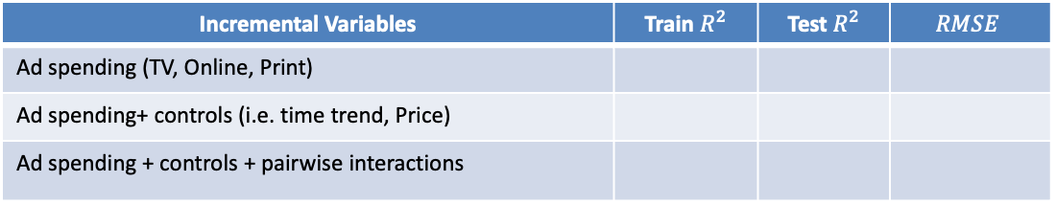
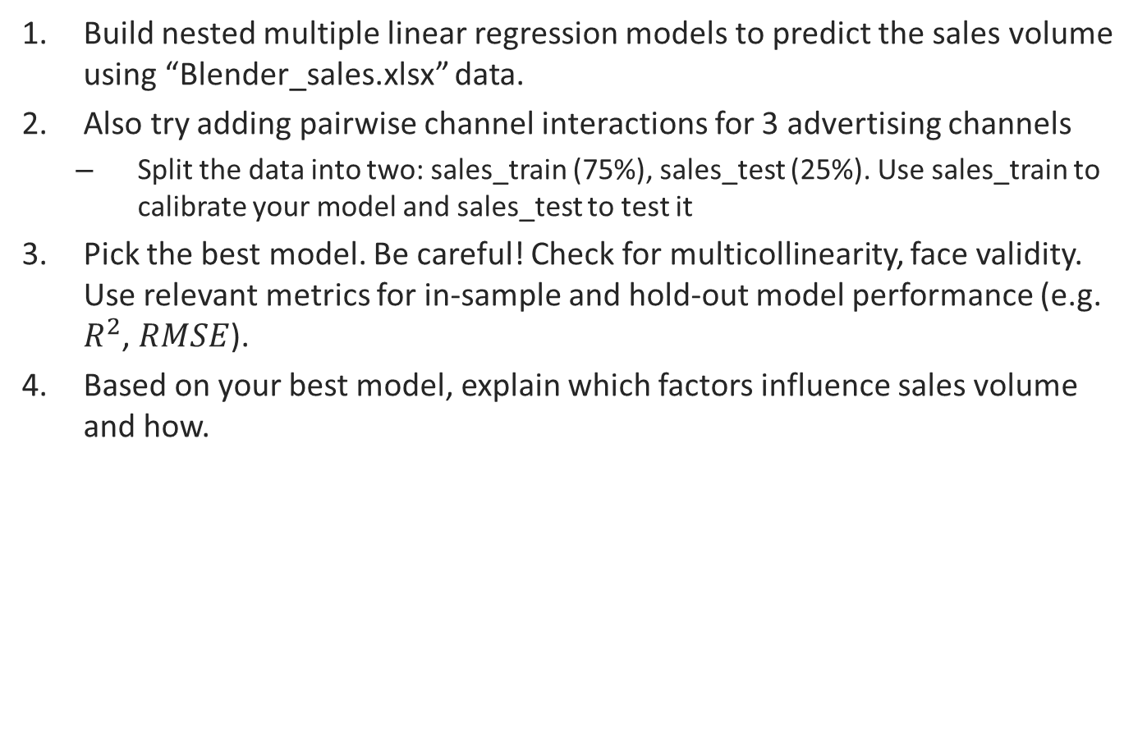
Your Goal
Build nested multiple linear regression models to predict the sales volume using “Blender_sales.xlsx” data.
Also try adding pairwise channel interactions for 3 advertising channels
Split the data into two: sales_train (75%), sales_test (25%). Use sales_train to calibrate your model and sales_test to test it
Pick the best model. Be careful! Check for multicollinearity, face validity. Use relevant metrics for in-sample and hold-out model performance (e.g. $R^{2}$, $RMSE$).
Based on your best model, explain which factors influence sales volume and how.
Incremental Variables | Train $R^{2}$ | Test $R^{2}$ | $$RMSE$$
Ad spending (TV, Online, Print)
Ad spending+ controls (i.e. time trend, Price)
Ad spending + controls + pairwise interactions
Points to consider:
Transformation of the IVs to capture the different nonlinear relationships with sales
Adopting a Koyck (i.e. AR(1)) structure to account for carryover effects of advertising

Slide 5
Assignment Details
Goal:
Following the necessary steps in modeling as discussed today, build a MMM to understand the drivers of sales volume
Details
Stick to 2-3 pages text. Exhibits are not included in the page limit.
Submit only one assignment for your team via Dropbox. Any team member can make the submission. Make sure to have all team members’ names on the report.
The reports should include, similar to today’s amusement park exercise:
The highlights of your analysis (e.g. data investigation, checking for violations of assumptions, model comparison, holdout prediction as a test for overfitting) with graphs and tables to assist presentation of your findings where necessary
Your interpretation of the results and discussion of implications for the marketing managers

